Slide 1
CLINICAL TRIALS

Slide 2
What is a clinical trial?
Biomedical or health-related research studies in human beings that follow a PREVIOUSLY defined protocol.
Protocol=study plan which details what researchers will do in the study. It describes what types of people may participate in the trial; the schedule of tests, procedures, medications, and dosages; and the length of the study.
FOLLOWING PROTOCOL IS EXTREMELY IMPORTANT TO RESEARCH AND MAKING SOUND CONCLUSIONS BASED ON THE DATA
Interventional studies
research subjects are assigned by the investigator to a treatment or other intervention, and their outcomes are measured.
Observational studies
individuals are observed and THE VARIABLES OF INTEREST are measured by the investigators.

Slide 3
What are the different types of clinical trials?
Treatment trials test experimental treatments, new combinations of drugs, or new approaches to surgery or radiation therapy.
Prevention trials look for better ways to prevent disease in people who have never had the disease or to prevent a disease from returning. These approaches may include medicines, vaccines, vitamins, minerals, or lifestyle changes.
Diagnostic trials are conducted to find better tests or procedures for diagnosing a particular disease or condition.
Screening trials test the best way to detect certain diseases or health conditions.
Quality of life trials (or Supportive Care trials) explore ways to improve comfort and the quality of life for individuals with a chronic illness.

Slide 4
What happens during a clinical trial?
The clinical trial team includes doctors and nurses as well as RESEARCHERS, social workers and other health care professionals.
INFORMED CONSENT FORMS ARE GATHERED BEFORE PARTICIPATION CAN BEGIN
check the health of the participant at the beginning of the trial
give specific instructions for participating in the trial
monitor the participant carefully during the trial
stay in touch after the trial is completed
Some clinical trials involve more tests and doctor visits than the participant would normally have for an illness or condition. For all types of trials, the participant works with a research team.
Clinical trial participation is most successful when the protocol is carefully followed and there is frequent contact with the research staff.

Slide 5
What is informed consent?
The research team provides an informed consent document that includes details about the study, such as:
purpose
duration
required procedures
key contacts
Risks and potential benefits are explained in the informed consent document.
The participant then decides whether or not to sign the informed consent document.

Slide 6
Phases of Clinical Trials
Phase 1
Tests a new drug’s safety in the human body.
Small number of healthy volunteers needed.
Phase 2
Tests for effectiveness and dosage in several hundred patients.
Often there are 2 groups:
Active treatment
Control group to receive placebo
A control group is the standard by which experimental observations are evaluated.
One group of patients will be given an experimental drug or treatment, while the control group is given either a standard treatment for the illness or a placebo.
A placebo is an inactive pill, liquid, or powder that has no treatment value.
In clinical trials, experimental treatments are often compared with placebos to assess the experimental treatment's effectiveness.

Slide 7
Phases of Clinical Trials
Phase 3
Measures the drug or procedure against the best standard treatment.
Last phase before submission to the FDA for approval.

Slide 8
How is the safety of the participant protected?
The ethical and legal codes that govern medical practice also apply to clinical trials.
The trial follows a carefully controlled protocol:
Protocol=study plan which details what researchers will do in the study. It describes what types of people may participate in the trial; the schedule of tests, procedures, medications, and dosages; and the length of the study.
When researchers report the results of the trial at scientific meetings, to medical journals, and to various government agencies... Individual participants' names will remain anonymous.
PARTICIPANTS MUST BE MADE AWARE OF ANY BENEFITS OR RISKS OR POTENTIAL HARM THAT COULD RESULT FROM PARTICIPATION

Slide 9
What are benefits and risks of participating in a clinical trial?
Benefits
Play an active role in their own health care.
Gain access to new research treatments before they are widely available.
Obtain expert medical care at leading health care facilities during the trial.
Help others by contributing to medical research.
Risks
serious or even life-threatening side effects AS A RESULT OF experimental treatment.
experimental treatment may not be effective for the participant.
Protocol may require more of their time and attention than would a non-protocol treatment, including trips to the study site, more treatments, hospital stays or complex dosage requirements.

Slide 10
Who sponsors clinical trials?
Organizations or individuals such as:
physicians
medical institutions
foundations
voluntary groups
pharmaceutical companies
Federal agencies such as:
National Institutes of Health (NIH)
Department of Defense (DOD)
Department of Veteran's Affairs (VA)
Trials can take place in a variety of locations, such as:
hospitals
universities
doctors' offices
community clinics

Slide 11
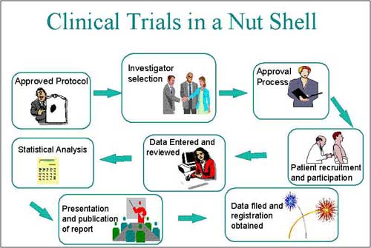
http://pharmaresearchdevelopment.blogspot.com/2010/12/clinical-trial-in-nut-shell.html

Slide 12
Current Clinical Trials at UK
http://www.mc.uky.edu/research/pages/currentstudies.htm

